Slide 1
Tunes & more
„THE“ ultimate Song recommending App
Developers / Marketing CLUSTER team :
Senda Nasr
Natalia Rodrigo
Eleder San Sebastian

Slide 2
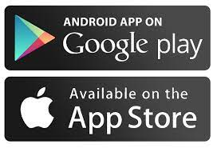
Introduction
What is Tunes & more?
Song recommending app free to download for users.
Integration on streaming platforms and online shops(YouTube, Apple Music, etc.)
Mission?
Enhance music discovery for users while creating revenue opportunities.

Slide 3
Features
Personalized recommendations via advanced algorithms to optimize the user experience
Seamless Integration with popular music streaming platforms to access a wider user database.
User-Friendly Interface: Intuitive design for a smooth and engaging user experience (in progress)

Slide 4
Revenue Streams
Commission based:
Merchandising Opportunities: Offer artist merchandise directly through the app
Album/single Sales: Facilitate digital, CD, and vinyl sales of singles and albums.
Concert Tickets: Integration with ticketing platforms for easy access to upcoming tours.
Own revenue means:
Premium features: premium membership (priority purchasing of tickets, ad-free)
Membership fees for distributors (“smaller” online shops selling CD, Albums, etc.)

Slide 5
Future Roadmap
Expansion Plans:
Explore partnerships with additional music streaming platforms or online shops.
Extend size of our song database
Extend the recommender to other products: books, movies, etc.
Community Engagement:
Extend app features based on user feedback and market trends.
Develop a strong user community through feedback forums and social media.
Continuous improvement for an ever-evolving music discovery experience.

Slide 6
Interface
How does it look like?

Slide 7
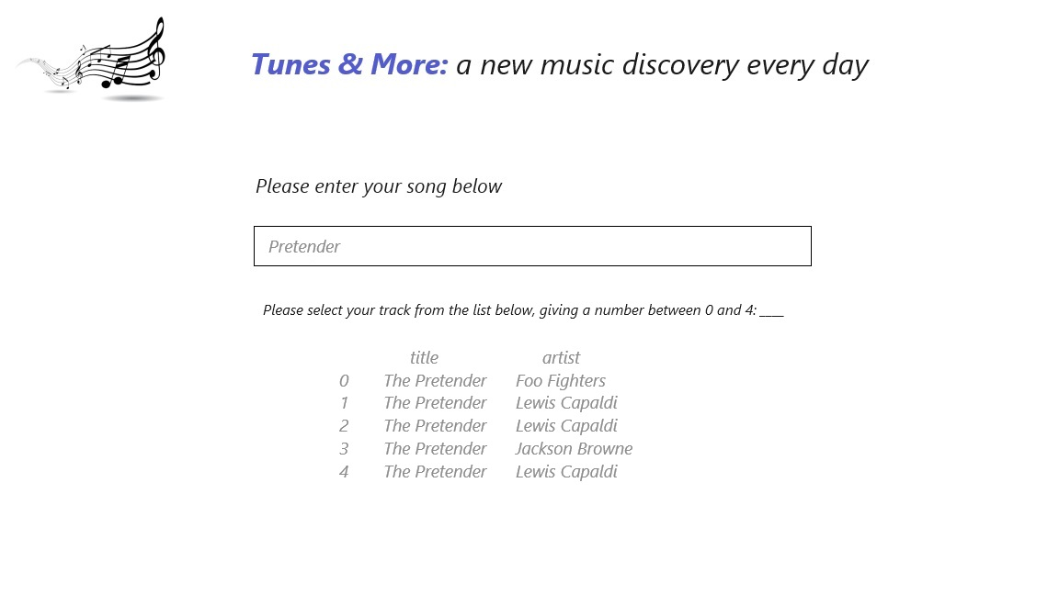
Interface: Step 1

Slide 8
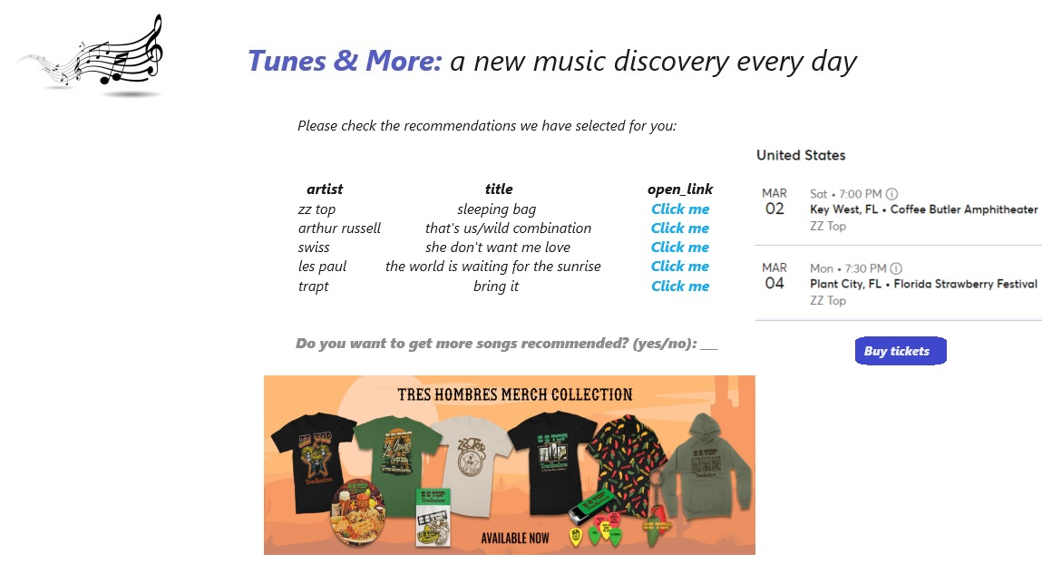
Interface: Step 2

Slide 9
Demo
Check the functionality

